Slide 1
A Healthy Mind Helps Make a Healthy Body
Tuna Mina Aylı

Slide 2
All human activities spread over the entire life span are governed by the mind. The subtle and imperceptible thoughts and feelings arising in the mind determine the nature and direction of human actions. The end-results of these actions are also accordingly determined. Together with other aspects of life, physical health too, is to a large extent subject to this power of mind. Our mind can either sap or strengthen the body’s defenses, depending on the nature of its frame. Inner malice and ugliness get reflected in poor health. Conversely, good physical health denotes a healthy state of mind.

Slide 3
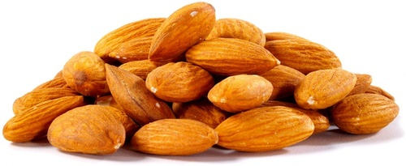
Quick Tips for a Healthy Mind, Body & Spirit
Keep Almonds on Hand
Store almonds in the freezer to keep them fresh. Spice them up for an appetizer, toss them in a salad or eat a handful for a snack. Almonds offer a satisfying carbohydrate-protein combo; plus, they’ve been shown to reduce cholesterol levels.

Slide 4
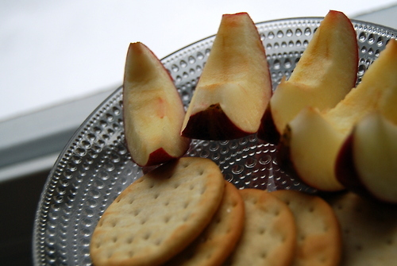
Read Labels When Shopping for Crackers
Pick crackers with fiber-rich whole grains, as few ingredients as possible and no hydrogenated oils (a source of heart-harming trans fats.)

Slide 5
Replace Full-Fat Sour Cream
Instead, use reduced-fat sour cream and nonfat plain yogurt. You'll save calories and fat without sacrificing flavor.

Slide 6
Start Your Meal With Soup
Research suggests that starting dinner with a vegetable-based soup may help you to consume 20 percent fewer calories over the course of your meal.

Slide 7
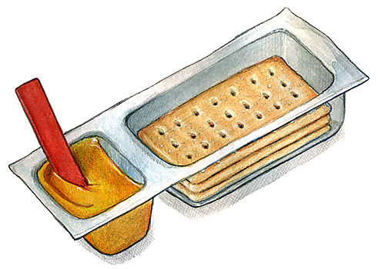
Use Stronger Cheeses
Use cheeses like extra-sharp Cheddar—they give a bigger flavor impact so you can use less and cut saturated fat and calories.

Slide 8
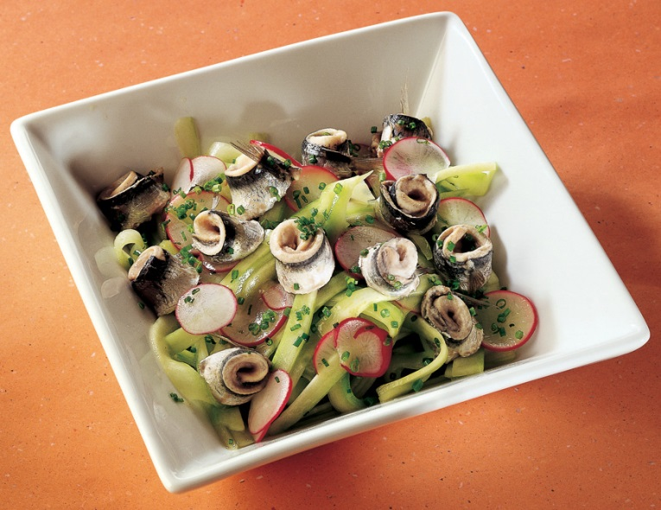
Top Your Salad With Sardines
Per 3-ounce serving, you'll get a whopping 1,950 mg of heart-healthy omega-3s—the most from any fish available.

Slide 9
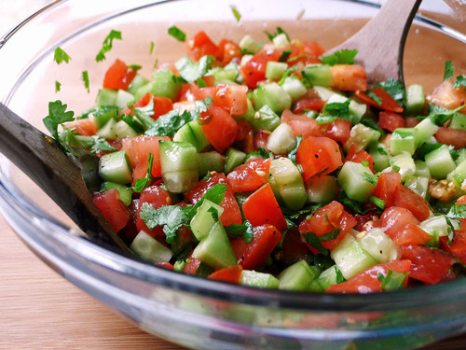
Skip Canned Vegetables
Opt for frozen vegetables when you're looking for convenience. Canned veggies usually have added sodium, while frozen vegetables don't.

Slide 10
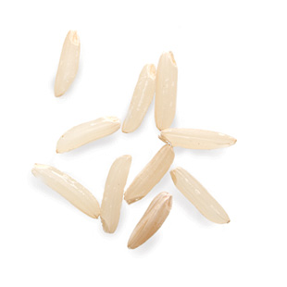
Opt for Brown Rice
Opt for brown rice over white rice whenever possible to add fiber to your diet. Per cup, brown rice has 3 more grams of fiber than white.

Slide 11
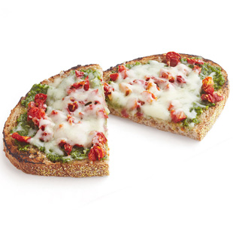
Serve Sandwiches Open-Face
You'll save about 100 calories simply by ditching that top slice of bread.

Slide 12
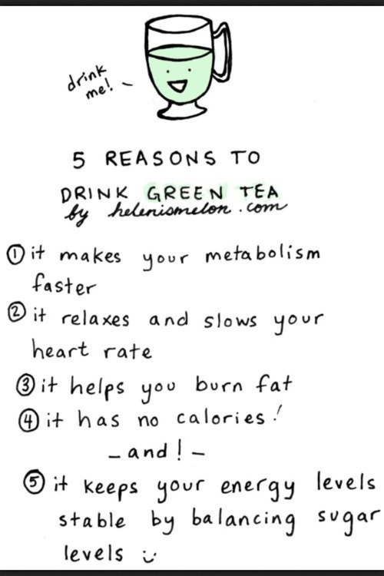

Slide 13
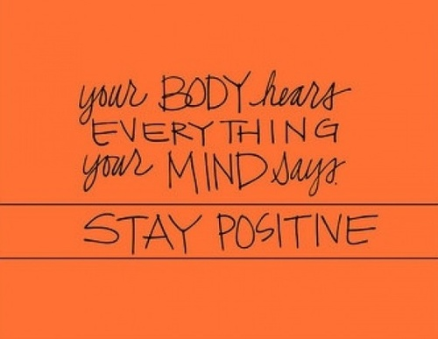

Slide 14
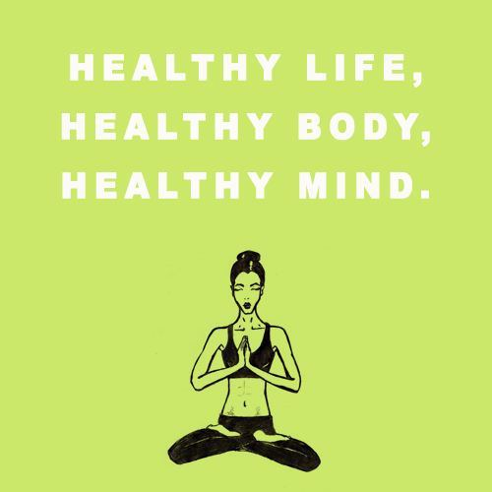

Slide 16
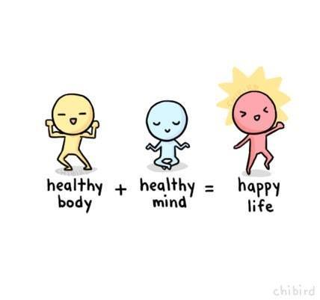

Slide 17
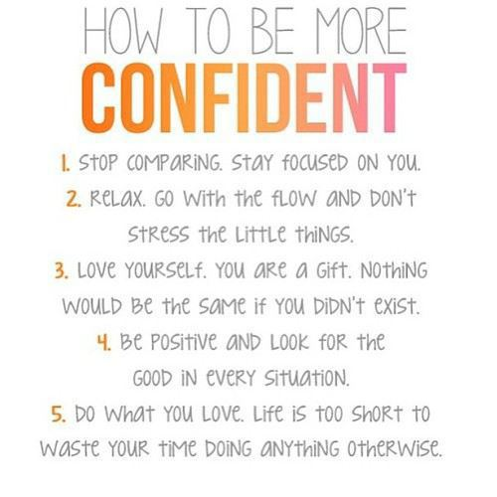

Slide 18
The greatest wealth is health. –Virgil

Slide 19
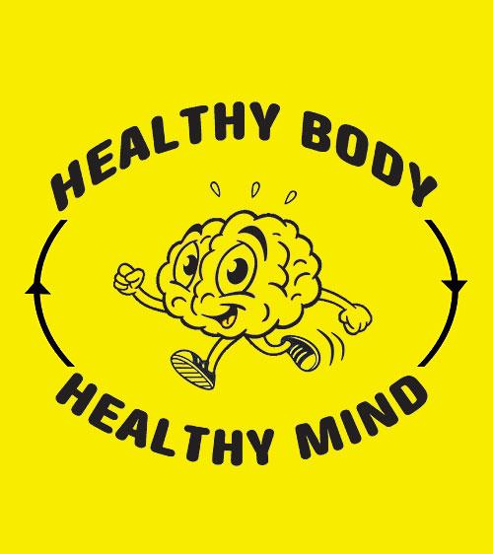

Slide 20
Some Extra Useful Tips;;
Arrange the equipment so there is plenty of space for general exercise. Also if you have too much space, you might want to layout your exercise equipments for circuit training. This involves arranging a series of stations, each for a different exercise, sometimes involving equipments such as a multi-gym rowing machine, weights or even a skipping rope. The basic idea is to move around the circuit, working at each station in turn. With that you can set your own pace too. Circuit training actually helps all aspects of fitness like stamina, strength and suppleness. It also ensures that all body parts gets a thorough workout. Of course you can alter the number or sequence of exercises.

Slide 21
Get an exercise mat. It is really useful. Specially is the fitness area has a hard cemented floor. This makes the floor exercises more comfortable and ensures that high impact activities put less strain on the joints. In the circuit training, you can place a mat in the centre, so you can include floor based exercises or stamina building activities like jogging on the spot. If you need you can also buy a mini trampoline. It helps build stamina and provides low-impact muscle-boosting exercise. It is handy if the space is limited, as it can be folded flat for storage.

Slide 22
Remember the money factor. Improvise wherever you can. For example you can either buy a branded exercise step, or you can also use a low bench or the first stair or something like that. Similarly you can either buy set of dumbbells of different weights or you can substitute it with cans of vegetables or soups or probably some water-filled plastic bottles. Improvise, exercise and save money. Again, all upto you!

Slide 23
When it comes to leg toning exercises, i always prefer using a canvas bag (let’s say a bag of flour). You need to sit on a table with the handles of the bag over your ankle. Then you just have to slowly lift up and down to work the leg muscles. That’s another improvisation!

Slide 24
As for the machinery, of all, i think rowing machines are one of my favorites. They are affordable, collapsible and great for whole body fitness. You can place it anywhere whether bedroom or living room and you can row to your favorite music.

Slide 26
What is the meaning of a Healthy mind is a healthy body?
That means that if you think first about what you're going to eat - the thought should be healthy - or whatever you're going to do, maybe thinking about if you want to smoke or take drugs, if you say no to the bad things you're using a healthy mind to develop a healthy body. A healthy mind is a sensible, good mind.

Slide 27
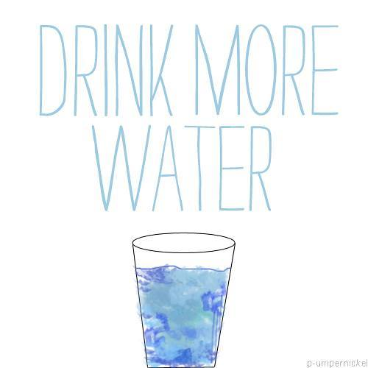

Slide 28
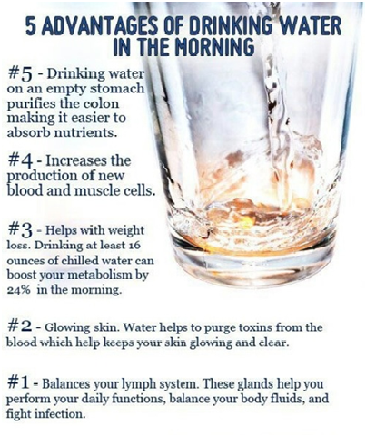

Slide 29
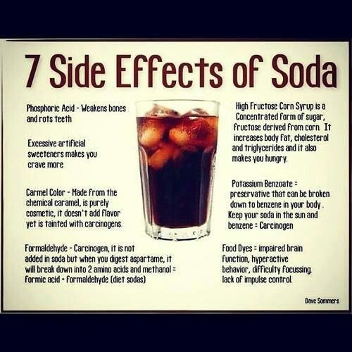

Slide 30
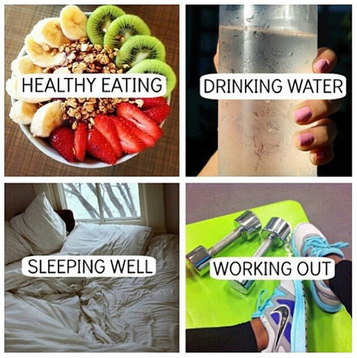
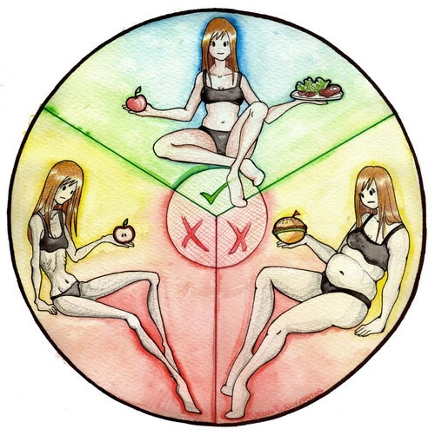

Slide 31
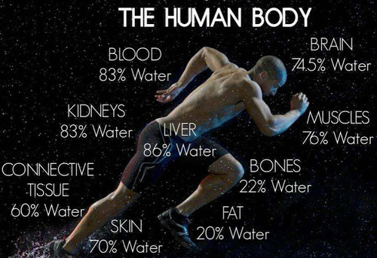

Slide 33
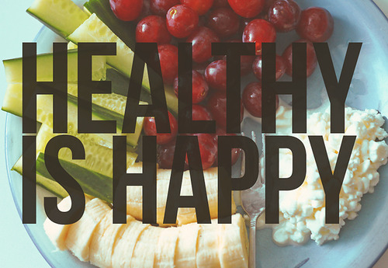

Slide 34
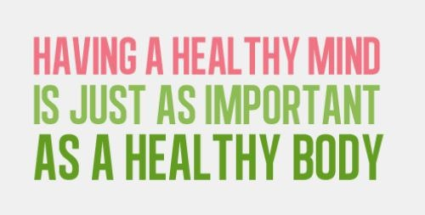

Slide 35
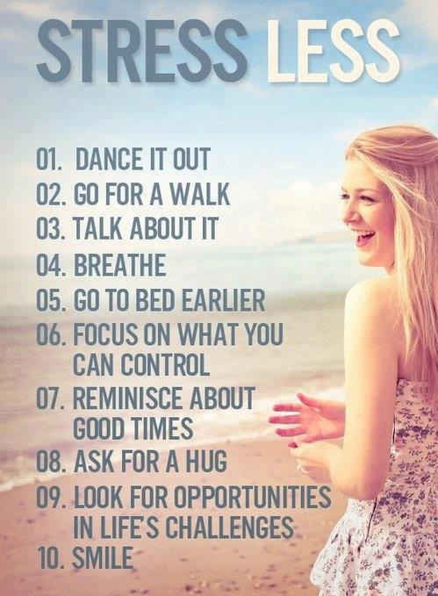

Slide 36
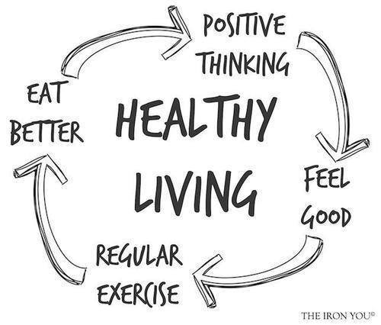

Slide 37
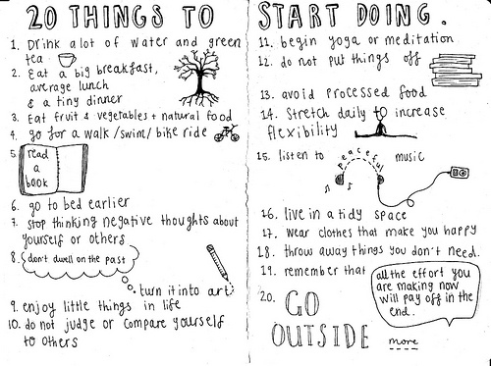

Slide 38
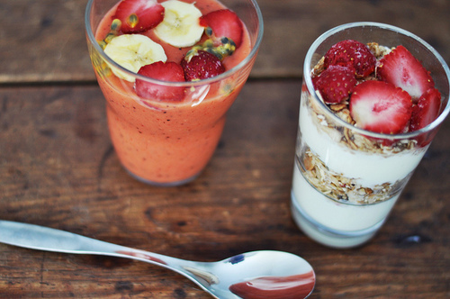

Slide 41
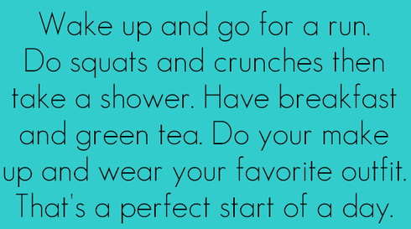

Slide 43
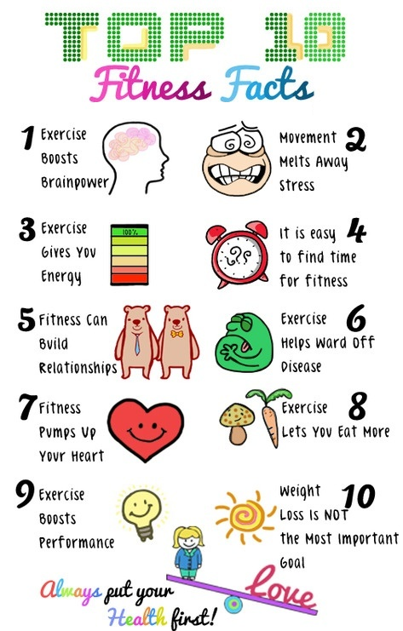

Slide 44
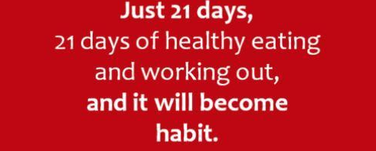

Slide 45
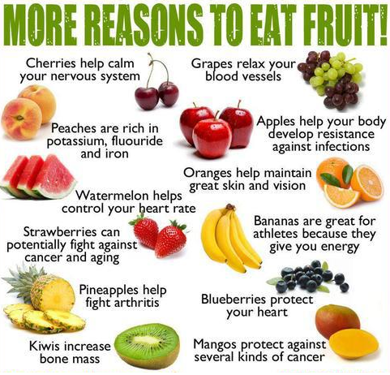

Slide 46
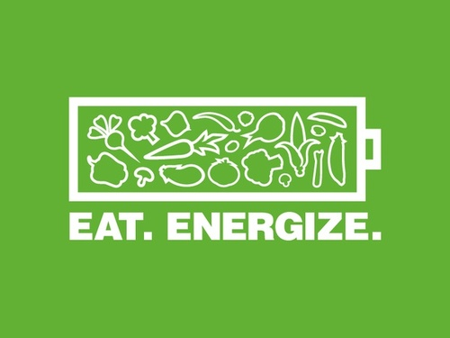
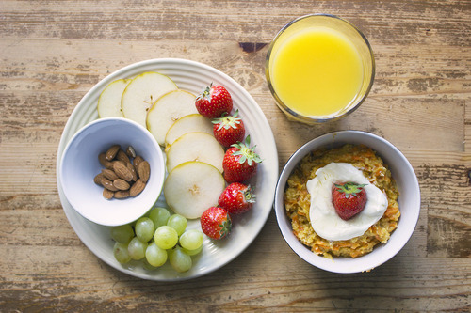

Slide 49
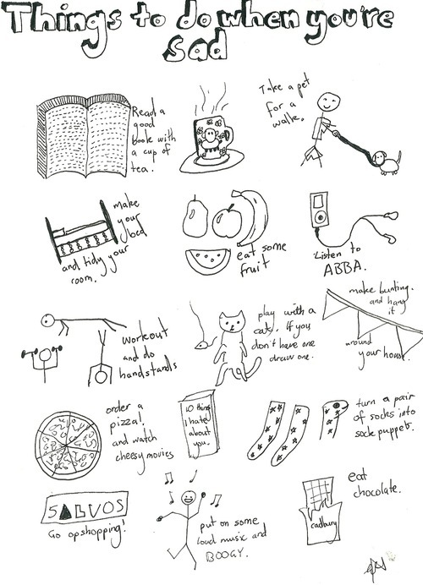

Slide 50
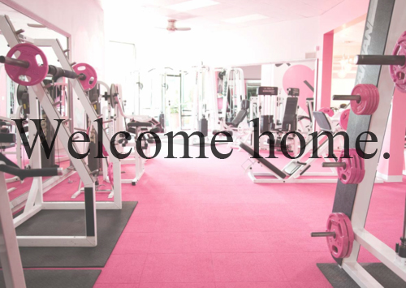
Live happy! Exercise and have a healthy body and a healthy mind.

